Slide 1
07
Session 7 of 24
pandas I: load, look and filter
How do we open a file of 30,229 rows and ask the first questions of it?
Jotham Martin Wambi, KLAi Professional Learning
Session 7 pandas I: load, look and filter
1
Notes:
Today the file gets big. Until now you've worked with a few numbers and a price list. In Session 7 we open the Lakeside Mart orders, thirty thousand two hundred rows of them, and start asking questions in Python. By the end you'll have loaded the file, looked it over before trusting it, and answered six questions that you can check against Sheets.

Slide 2
By the end of today
How the two hours run
Load a CSV into a DataFrame.
Recall and warm-up
10 min
Inspect shape, types and missing values.
Concepts and explanation
30 min
Live demonstration
25 min
Select columns and filter rows.
Break
5 min
Guided lab
40 min
Check and wrap-up
10 min
Session 7 pandas I: load, look and filter
2
Notes:
You'll leave able to load a CSV file into what Python calls a DataFrame, inspect its size, column types and gaps before you trust any answer, and then select columns and filter rows to ask focused questions. The live part sits in the middle, where we load orders.csv together and watch one filter fail on purpose. The lab is six questions about Jinja, mobile money and the biggest orders, and every answer gets checked against Sheets.

Slide 3
Vocabulary
Word | Plain meaning | In a spreadsheet
DataFrame | A table held in Python's memory, with named columns and numbered rows. | A worksheet
Series | One column of a DataFrame. | A column
Index | The row labels down the left edge of a DataFrame. | The row numbers
Boolean mask | A column of True and False values used to choose rows. | A helper column saying Keep or Drop
Method | An action attached to an object, written with a dot and brackets, such as head(). | A menu command
Attribute | A fact stored on an object, written without brackets, such as shape. | A value in the status bar
Session 7 pandas I: load, look and filter
3
Notes:
Six words today, listed with their spreadsheet cousins on the right. A DataFrame is a worksheet that lives in Python, and a Series is one column of it. The index is the row numbers down the left side. A boolean mask is a helper column of True and False that decides which rows you keep. A method is an action such as head, and an attribute is a fact such as shape. You've used every one of these ideas in a spreadsheet. Only the names are new.

Slide 4
Warm-up from Session 6
1
You wrote a function that gives a loyalty tier from spend. How did you know it worked?
Test it on examples where you already know the answer, including the edge values.
2
What does a for loop replace in a spreadsheet?
Dragging a formula down a column, row by row.
Session 7 pandas I: load, look and filter
4
Notes:
Session 6 first. You wrote a function that gives a loyalty tier from spend. How did you know it worked? Cast your mind back.
You tested it on examples where you already knew the right answer, and you included the edge values, such as a spend exactly on a tier boundary. That habit matters even more today, because we'll check every pandas answer against Sheets.
Second. What does a for loop replace in a spreadsheet? Take it slowly.
It replaces dragging a formula down a column. Today we go a step further. pandas applies a calculation to a whole column without any loop at all.

Slide 5
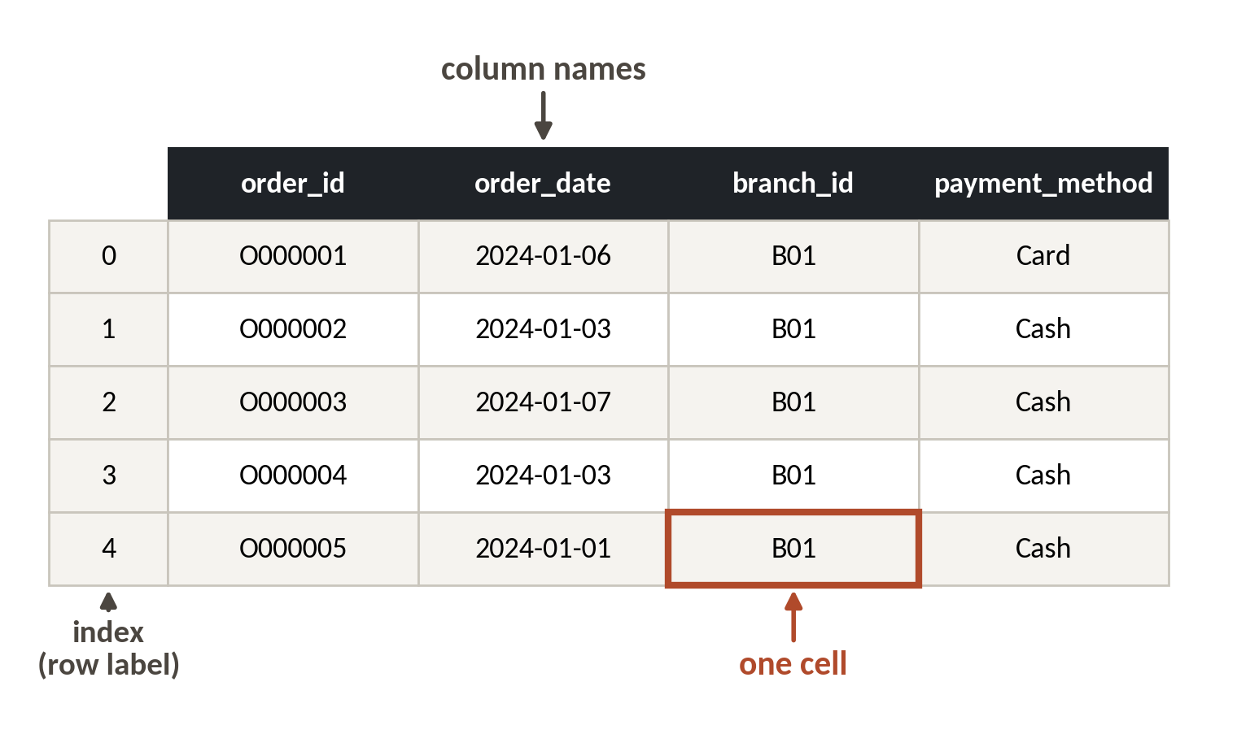
A DataFrame is a worksheet that lives in Python
Every pandas job starts with one of these. Learn its four parts and the rest follows.
Columns. Each has a name and one type, such as text or whole number.
Rows. Each row is one case. Here, one order.
Index. The numbers down the left edge. They start at zero.
Cell. One value, found by its row and column.
Session 7 pandas I: load, look and filter
5
Notes:
You'll use this object from here to the end of the course. A DataFrame is a worksheet that lives in Python.
On the right are the first five orders in the Lakeside Mart file. The names across the top are the columns. Each column holds one kind of thing, so order_id is text and promo_week is a whole number.
Each row is one order. The numbers on the far left are the index, and they start at zero. Excel starts its rows at one, so this takes a day or two to feel natural.
One cell is the value where a row meets a column. The red box shows the branch for the row labelled four. Find the row, then the column.

Slide 6
The same five jobs in Excel and in pandas
Excel or Sheets
pandas
Open the file
read_csv('orders.csv')
Look at the first rows
.head()
Filter with AutoFilter
orders[orders.branch_id == 'B04']
Sort a column
.sort_values('order_value_ugx')
Count with a PivotTable
.value_counts()
Same jobs. Python writes each step down, so you can repeat it on tomorrow's file.
Session 7 pandas I: load, look and filter
6
Notes:
On the left, the five jobs you already do in a spreadsheet. On the right, the pandas line for each.
Opening the file becomes read_csv. The first rows appear with head.
Filtering comes next. Where AutoFilter has you open a dropdown, pandas has you write the condition. After that, sorting a column becomes sort_values.
The fifth job is counting. A PivotTable gives you counts by group. In pandas that's value_counts, and we'll use it at the end of the demonstration.
The verdict at the bottom says the rest. Same jobs. The difference is that Python writes each step down, so next month you run the same lines on a new file and get the same answers without clicking anything.

Slide 7
Load the file, then look before you ask
import pandas as pd
orders = pd.read_csv('orders.csv')
print(orders.shape)
orders.head(3)
Output
(30229, 7)
order_id order_date branch_id customer_id payment_method promo_week order_value_ugx
O000001 2024-01-06 B01 C0495 Card 0 56000
1
Bring in pandas and call it pd, the name everyone uses.
2
Read the file into a DataFrame and name it orders.
3
shape is an attribute with rows then columns. head shows the first rows.
Session 7 pandas I: load, look and filter
7
Notes:
Let's do it live, with the first thing you do to any file.
import pandas as pd brings in the table library and gives it the short name pd. Everyone writes it exactly this way, so you'll recognise it in any code you ever read.
read_csv reads the file, and we store the result under a name, orders. The name is ours to choose, so pick one that says what is inside.
Then shape gives the size. Thirty thousand two hundred and twenty nine rows and seven columns. And head shows the first rows, so we see what we're dealing with before we ask anything.

Slide 8
Check the types and what is missing
print(orders.dtypes)
print()
print(orders.isna().sum())
1
dtypes lists each column's type. Text shows as object.
Output
2
isna marks the empty cells. sum counts them for each column.
order_id object
order_date object
branch_id object
customer_id object
payment_method object
promo_week int64
order_value_ugx int64
customer_id 9171
Session 7 pandas I: load, look and filter
8
Notes:
Second look. Types and missing values.
The dtypes line gives each column's type. Python calls text object, and whole numbers int64. Notice that order_date is shown as object. Python is treating the date as plain text, and we'll fix that in the next session.
The next line asks which cells are empty and counts them for each column. Only customer_id has gaps, nine thousand one hundred and seventy one of them. Those are walk-in customers who didn't give a loyalty number, so the gap tells us something about the shoppers.

Slide 9
info and describe: two summaries in one line each
orders.info()
print()
orders.order_value_ugx.describe().round().astype(int)
1
info lists every column with its count of filled cells and its type.
Output
RangeIndex: 30229 entries, 0 to 30228
3 customer_id 21058 non-null object
6 order_value_ugx 30229 non-null int64
count 30229
mean 47491
std 123574
min 800
25% 9940
50% 23200
75% 47300
max 3104000
2
describe gives count, mean, spread and quartiles for one number column.
3
The 50% row is the median. It is 23,200 here.
Session 7 pandas I: load, look and filter
9
Notes:
Two more calls that you'll use on every new file. info and describe.
Start with info. It lists every column with its type and how many cells are filled. Thirty thousand two hundred and twenty nine orders, but customer_id has only twenty one thousand and fifty eight filled. That's the same gap we just counted, seen from the other side.
Then describe, which works on a number column. It's the summary row you'd build in Excel with COUNT, AVERAGE, MIN and MAX, all in one go.
The 50 percent line is the median, twenty three thousand two hundred shillings. The mean above it is forty seven thousand four hundred and ninety one, and the biggest order is over three million. That gap between mean and median is worth a picture, and we'll draw one shortly.

Slide 10
The first five minutes with any new file
Load
Size
Look
Types
Missing
pd.read_csv('file.csv')
.shape
.head()
.dtypes
.isna().sum()
Run these five in this order on every file you ever meet.
Session 7 pandas I: load, look and filter
10
Notes:
Here's the routine to memorise. Five steps, same order, every file.
First you load the file. It sounds obvious, but loading is where wrong separators and wrong file names show up first.
Second, size. How many rows and columns?
Third, you look, with head. A table that has twelve columns when you expected seven tells you something is off.
Fourth, types. A date held as text or a number held as text will quietly break your sums later.
Fifth, missing values. Count them by column. After these five steps you know the file well enough to ask it proper questions. Don't skip them just because you're in a hurry.

Slide 11
Choosing columns and rows
Square brackets do both jobs. What goes inside decides which.
One column
orders['branch_id'] gives a Series.
Several columns
orders[['branch_id', 'payment_method']] uses a list inside the brackets.
Some rows
orders[orders.branch_id == 'B04'] keeps the rows where the test is True.
Session 7 pandas I: load, look and filter
11
Notes:
Square brackets do two jobs, and what you put inside them decides which. This confuses people at first.
One name in quotes gives you one column. That column is called a Series. Two names in a list, so double brackets, give you a smaller table with just those columns.
The third form is the one you'll use all day. Inside the brackets you put a test. The test runs on every row and gives back True or False. pandas keeps the rows that are True. That column of True and False values is called a boolean mask. It's exactly the helper column you'd add in Excel before filtering, only you never see it.

Slide 12
Filter rows with a test
jinja = orders[orders.branch_id == 'B04']
print(len(jinja))
jinja.payment_method.value_counts()
1
The test gives True or False for every row. Only True rows are kept.
Output
2
len counts rows. B04 is the Jinja branch.
3562
Mobile money 1695
Cash 1619
Card 248
3
Count the payment methods inside that filtered table.
Session 7 pandas I: load, look and filter
12
Notes:
Jinja is branch B04, so let's filter for it.
The condition says branch_id equals B04. Note the double equals sign. A single equals stores a value. A double equals asks a question. We keep only the rows where the answer is True and store them in a new table called jinja.
Next we count the rows with len. Jinja has three thousand five hundred and sixty two orders in the file.
Then value_counts on the payment column shows how those orders were paid. Mobile money leads with sixteen hundred and ninety five, cash follows with sixteen hundred and nineteen, and cards are rare at two hundred and forty eight. AutoFilter in Sheets should give you the same counts, and in the lab you'll check that.

Slide 13
Two conditions: use & and brackets
mm_jinja = orders[(orders.branch_id == 'B04') & (orders.payment_method == 'Mobile money')]
print(len(mm_jinja))
Output
1695
1
Each test goes in its own brackets.
2
& means AND. A bar, |, means OR.
Session 7 pandas I: load, look and filter
13
Notes:
Two conditions at once. Orders from Jinja that were paid by mobile money.
Each test sits in its own round brackets, and the ampersand joins them. Ampersand means and. A vertical bar means or. The brackets matter. Without them Python reads the line in the wrong order and stops with an error.
The answer is sixteen hundred and ninety five, the same number we saw a moment ago for mobile money in Jinja. When two routes give the same answer, you can trust it more.

Slide 14
What happens if you write and
orders[orders.branch_id == 'B04' and orders.payment_method == 'Mobile money']
Output
ValueError: The truth value of a Series is ambiguous.
1
Python's own word and is for single True or False values.
Session 7 pandas I: load, look and filter
14
Notes:
Now the mistake nearly everyone makes. You write the English word and between two tests.
Python stops with an error that ends: the truth value of a Series is ambiguous. Read that last line, as we practised in Session 5. It says Python can't decide a single True or False for a whole column.
The cure is the ampersand with brackets, exactly as on the last slide.

Slide 15
A filter that quietly drops the wrong rows
What it looks like
Why it goes wrong
The fix
You filter orders with promo_week == 1 and report the average. It runs, with no error, and the number looks sensible.
A filter keeps only part of the data. If you forget the rest is gone, you report a figure for promo weeks as if it were all weeks.
Name the filtered table something that says what it holds, such as promo_orders, and print len() beside every figure you report.
Session 7 pandas I: load, look and filter
15
Notes:
This one produces no error at all.
You filter the orders to promotion weeks, calculate an average, and the number looks perfectly reasonable. Nothing warns you.
The trouble is that you've thrown away every order outside promotion weeks. If you then say the average order value is such and such, you've answered a question about promotions and presented it as an answer about everything.
So name the filtered table for what it holds, such as promo_orders, and print the row count next to every figure you report. A reader who sees the count knows what the figure covers.

Slide 16
Sort and keep the top five
top5 = orders.sort_values('order_value_ugx', ascending=False).head(5)
top5[['order_id', 'branch_id', 'order_value_ugx']]
Output
order_id branch_id order_value_ugx
O014303 B04 3104000
O029299 B08 2795740
O003810 B01 2771200
1
Sort by value, largest first.
2
Keep five rows, then show three columns.
Session 7 pandas I: load, look and filter
16
Notes:
Sorting and keeping the top few. In Excel you'd sort a column from largest to smallest and look at the top.
sort_values takes the column name. For largest first, set ascending to False. Then head with five keeps the first five rows.
The last line chooses just three columns to show. The biggest order in the file is O014303, from Jinja, at over three million shillings. Remember that number. Next we'll see why a few orders like this change the story.

Slide 17
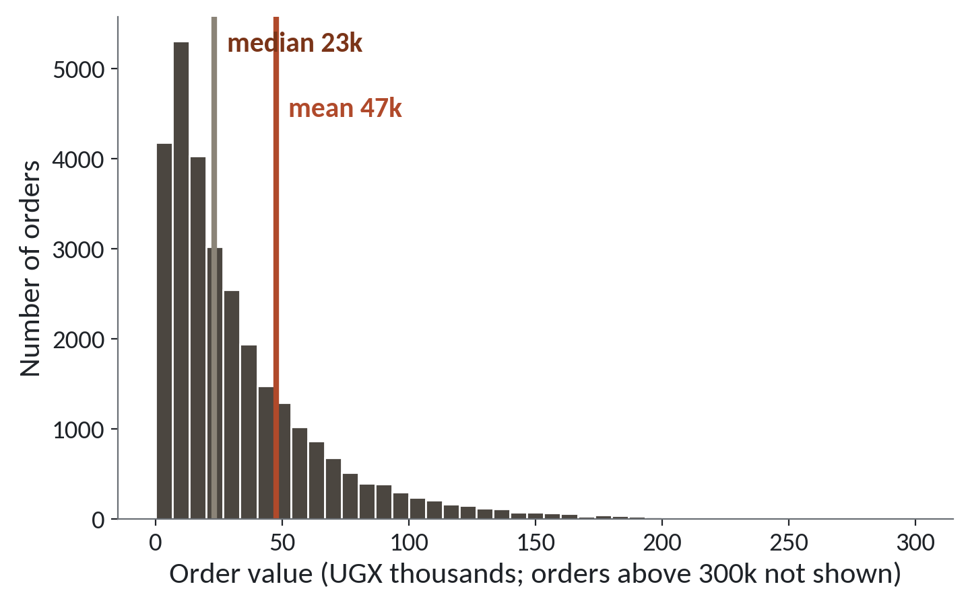
A few very large orders pull the average up
1
Most orders are small. The tallest bars sit on the left.
2
A long tail of large orders runs to the right.
3
The mean is more than double the median.
Median 23,200 UGX. Mean 47,491 UGX. Use the median when a few big orders distort the average.
Session 7 pandas I: load, look and filter
17
Notes:
Here's every order's value drawn as a histogram.
Most orders are small. The tallest bars sit on the left side. Then a long tail of large orders stretches to the right.
Because of those big orders, the mean, the red line, is pulled to the right. It's forty seven thousand four hundred and ninety one shillings. The median, the gold line, is twenty three thousand two hundred. The mean is more than double the median.
So which number do you report to a manager who asks about a typical order? Think about what you would say. The median, because it describes the typical order, and the mean describes a figure that few orders actually look like. You met this in Session 3, and it returns whenever a few big values bend an average.

Slide 18
Boolean mask
A column of True and False values, one per row, that decides which rows to keep.
In our data
In a spreadsheet
orders.branch_id == 'B04' gives True for every Jinja order and False for all others. orders[mask] keeps the True rows.
The helper column you add next to the data, with Keep or Drop in each row, before you filter on it.
Session 7 pandas I: load, look and filter
18
Notes:
The word for today is boolean mask.
In plain words, it's a column of True and False values, one for each row, that decides which rows to keep.
In our data, when you ask which orders have branch B04, Python builds that column. True for Jinja orders, False for every other branch. Put that mask inside the square brackets and you keep only the True rows.
You already do this in Excel. You add a helper column next to the data that says keep or drop, then filter on it. pandas builds the helper column for you and hides it.

Slide 19
Lab: six questions, six checks
1
Open the Session 7 notebook and run the setup cell
Tool and time
Google Colab
40 minutes
2
Load orders.csv, print its shape and missing values
3
Count the orders from Jinja (branch B04)
You are done when
4
List the ten largest orders by value
All six answers match Sheets. Where they differ, you can say why.
5
Count Jinja orders paid by mobile money
6
Count all orders by payment method
7
Compare every answer with Sheets
Session 7 pandas I: load, look and filter
19
Notes:
The lab is six questions about the orders, and it runs forty minutes in Google Colab.
Open the Session 7 notebook and run the setup cell. The first task is to load orders.csv and print its shape, and the check cell tells you straight away if you have it. Each later task has a blank for you to fill and a check underneath.
The last step is to take every answer and find it again in Sheets, with AutoFilter or a PivotTable. If Python and Sheets disagree, find out why before you pick one. I'll be around. If you get an error, read the last line first, then ask me.

Slide 20
Questions to finish
1
Your file has 30,229 rows. Which two lines tell you its size and its column types?
orders.shape for the size, and orders.dtypes for the types.
2
Why does orders[a == 1 and b == 2] fail, and what is the fix?
Python's and cannot handle a whole column. Use & with each test in brackets.
3
You report an average from a filtered table. What must sit beside it?
The row count, so the reader knows what the figure covers.
Session 7 pandas I: load, look and filter
20
Notes:
Start with size. Your file has thirty thousand rows. Which two lines tell you its size and its column types? Have a go.
The size comes from shape, and the types come from dtypes.
Next, a filter that fails. Why does a filter written with the word and fail, and what's the fix? Mull it over.
Python's own and can't handle a whole column of True and False values. Use the ampersand, with each test inside round brackets.
Last, an average from a filtered table. What must sit beside it? Give it a second.
The row count. It tells the reader how many rows the figure covers, and it protects you from reporting a part as if it were the whole.

Slide 21
Summary
A DataFrame is a worksheet in Python: columns have types, rows have an index.
Look before you ask: shape, head, dtypes, missing values, in that order.
A filter is a True or False test per row. Use & and brackets, and report the row count.
Next session. pandas II: cleaning the mess
Session 7 pandas I: load, look and filter
21
Notes:
A DataFrame is a worksheet that lives in Python. Its columns have types and its rows have an index.
Look before you ask. Size, first rows, types, then missing values, in that order, on every file.
A filter is a True or False test for each row. Join tests with an ampersand and brackets, and always report the row count beside any figure from a filtered table.
Next session we open the till system's raw export of these orders, with duplicate lines, dates in two formats and prices stored as text, and clean it up.

